Slide 1

PARKINSON’S
DISEASE
PT5000
Presented by: Guys & St Thomas Trust
Slides adapted from: Prof Isaac Sorinola

Slide 2
Learning outcomes
By the end of this lecture, students should be able to:
Discuss the epidemiology, aetiology, pathophysiology and clinical course of
Parkinson’s disease
Explain the current pharmacological therapy used in the management of
Parkinson’s disease
Discuss the evidence base for physiotherapy management of people with
Parkinson’s disease
Describe the role of the physiotherapist in assisting patients with PD in terms of direct intervention and patient related instruction to maximise function
Describe appropriate elements of exercise prescription for the patient with PD

Slide 3
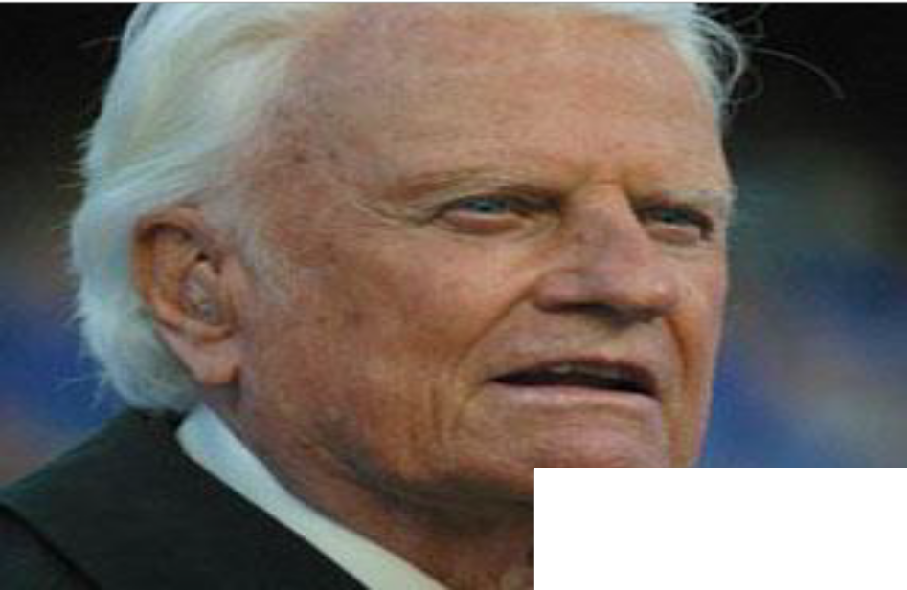
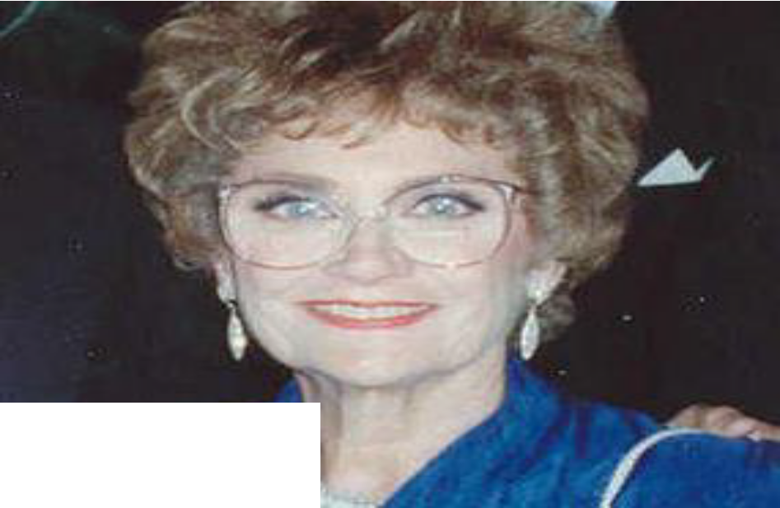
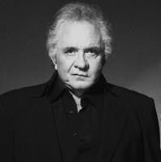
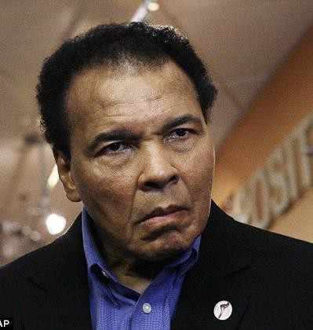
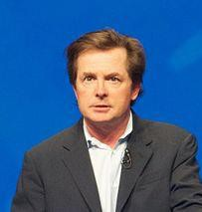

Slide 4
Definitions
Parkinsonism: Clinical syndrome characterised by disorders of movement – tremor, rigidity, bradykinesia, hypokinesia and postural abnormality
Parkinson’s disease (PD) or (paralysis agitans)
primary parkinsonism most common (78%)
Secondary parkinsonism – various causes

Slide 5
Causes of Parkinsonism
Class of disorder | Manifestation
Degenerative diseases | PD, Progressive supra-nuclear palsy, Multiple system atrophy
Infections | Post encephalitic Parkinsonism
Drug or toxin induced | Neuro-epileptics Carbon monoxide poisoning Manganese poisoning
Vascular conditions | Cerebrovascular disease Hypertensive encephalopathy
Trauma | Head injury Punch drunk syndrome
Cerebral tumour | Alzheimer’s disease
Other neurological conditions with Parkinson like features | Intermittent raised pressure hydrocephalus; Various forms of Huntington’s disease Wilson’s disease

Slide 6
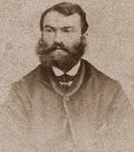
Parkinson Disease (Parkinson’s)
Chronic, slowly progressive degenerative disease
Idiopathic
“153,000 people live with PD in the UK = 1 person
in every 350” (Parkinson’s UK)
Onset age: variable, average age 55; only 1 in 20 cases in people aged under 50.
↑ prevalence with age; 1% of people aged above 65
Men slightly more affected (3:2)
James Parkinson

Slide 7
Aetiology of PD
Unknown but likely to be from combination of:
  Ageing
  Environmental toxins:
    MPTP
  Genetic susceptibility
    20% Hereditability; younger onset

Slide 8
Pathophysiology
Occurs in basal ganglia: striatum – (caudate N and putamen) and globus pallidus, subthalamic N, and substantia Niagra
Neuro-degeneration occurs mainly in the pars compacta of substantia Niagra – rich in neuromelanin-containing cells.
In PD, there is apoptosis of neuromelanin containing neurones
Immune cells remove these dying cells
Dopamine is depleted as a consequence of this.
The ↓ dopamine leads to:
  ↑ inhibitory drive to the thalamus, suppressing movement
  Changes in background tone - rigidity
  Releasing of inhibition of tremor

Slide 9
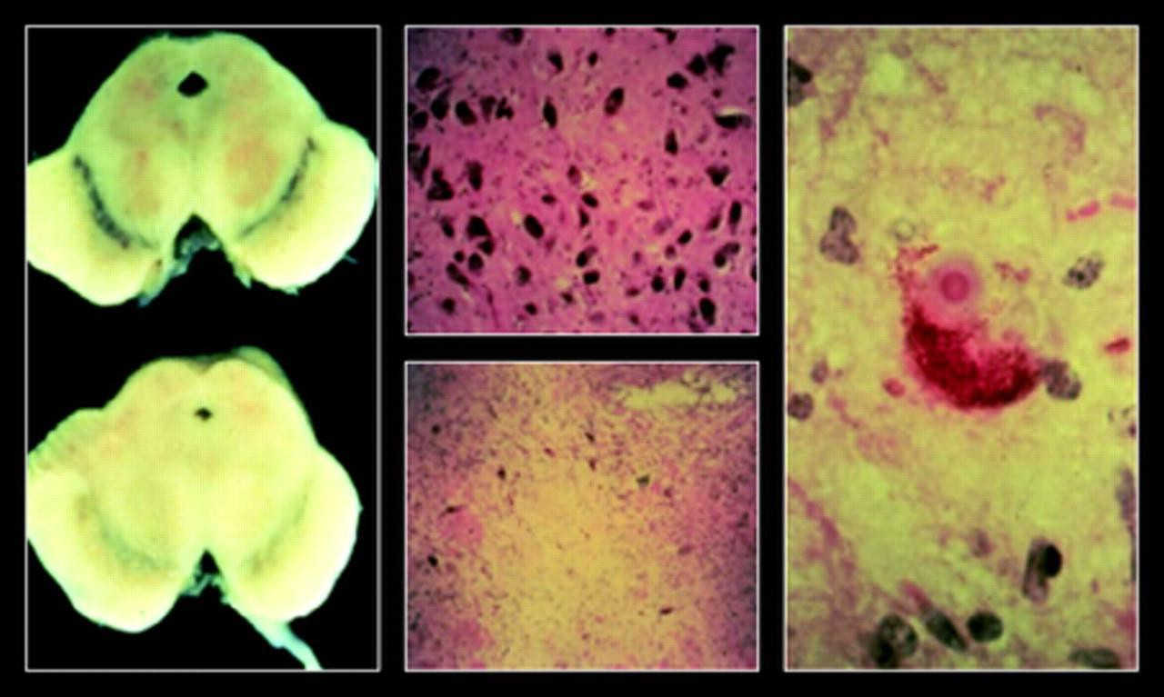

Figure 1 Classic pathology of PD. The left panel illustrates the marked reduction in neuromelanin pigment in the substantia nigra pars compacta (SNc) in a patient with PD (bottom) compared with a normal individual (top).
C. Warren Olanow et al. Neurology 2009;72:S1-S136
©2009 by Lippincott Williams & Wilkins

Slide 10
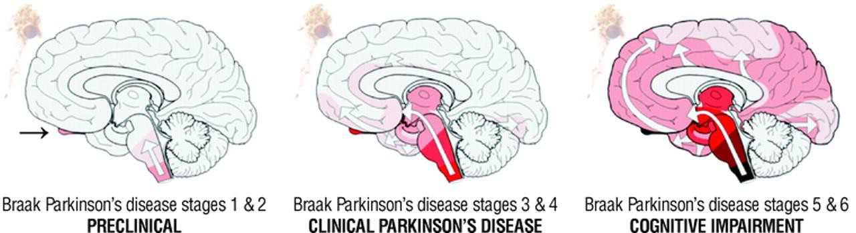
Later distribution of Lewy bodies in the cortex
Lower brainstem & Olfactory bulb
Extend to Substantia Niagra
Prodromal PD
Olfactory bulb (stage 1)
Brainstem involvement (stage 2)
Midbrain level
80% of dopamine neuron loss
Cognitive - dementia
Cortex involvement
- extra-niagral pathology including non-dopamine pathways - non –motor features
C. Warren Olanow et al. Neurology 2009;72:S1-S136
©2009 by Lippincott Williams & Wilkins

Slide 11
Diagnosing Parkinson Disease
Based on clinical examination by a specialist
  Neurologists – 93.5% accuracy
  Non-specialists =73.5% accuracy
Gold standard: neuropathological exam at autopsy
No biological marker that unequivocally confirms PD diagnosis

Slide 12
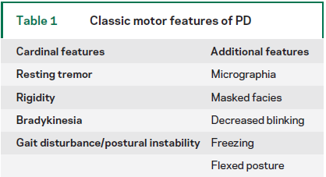
Cardinal Features – Clinical features
Non Motor Features
Autonomic dysfunction
Communication difficulties
Sensory disturbances & Pain
Mood disorders
Sleep impairment
Dementia
Falls

Slide 13
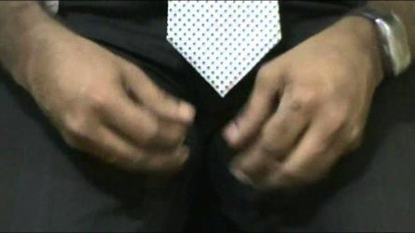
Cardinal sign: Resting Tremor
Involuntary oscillation of body parts at slow frequency of about 4 to 6Hz
initial symptom 50% of PD cases
Resting tremor; “pill-rolling”
Postural tremor (8-12Hz) may also be present
Diminishes with voluntary effort; disappears completely during sleep
Aggravated by stress and fatigue
Origin is disputed; hypothesized to be as a result of oscillations in a hyperactive long loop reflex pathway

Slide 14
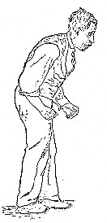
Cardinal sign: Rigidity
Increased stiffness - passive ROM
cogwheel and lead pipe; cogwheel rigidity is pathognomonic of PD
unequal in distribution
decreases ability to move easily
Rigidity affecting neck, trunk and knees leads to stooped posture
Not constant – affected by stress, anxiety, movt of contralateral limb, posture

Slide 15
Cardinal sign: Bradykinesia
Bradykinesia - used interchangeably with akinesia and hypokinesia
  Hypokinesia –reduced amplitude of movement
  Bradykinesia – slowness of movement
  Akinesia – loss of movement, slowness to initiate, freezing while moving
  Freezing –refers to the difficulty starting or continuing
rhythmic movement e.g. walking, handwriting , speech
It is the most disabling manifestation of PD

Slide 16
Cardinal Sign: Freezing
Freezing – refers to difficulty starting or continuing rhythmic
repetitive movements
Schools of thought exit which considers it a distinct clinical sign of PD
Freezing of Gait (FOG) is an episodic gait disturbance typically
experienced when walking
Festination often occurs prior to freezing
Feet appears glued to the floor while momentum carries body mass
forward
Occurs more frequently in cluttered environments, stressful circumstances or when patient is distracted
Likelihood of falls increases

Slide 17
Development of PD
Early stage may be vague and non-specific:
  e.g. inexplicable tiredness, unwarranted fatigability and mild
muscle aches and cramps
  Cognitive impairment affecting executive function & memory
– 25% of newly diagnosed cases
  Excessive levels of physical and mental fatigue common
  Depression may be present and adds to reduced QoL
As disease progresses
  Clinical signs and symptoms develops
  Leads to embarrassing and upsetting incidence
  Movement difficulties compromises independence and confidence

Slide 18
Problems in PD
Loss of automaticity: - inability to perform movement without attention
directed towards the movement
  Habitual behaviour is affected
  Flexibility of motor behaviour is reduced
  Dual tasking is impaired
  Exaggerated dependence on external motor drive
Contributes to micrographia, decreased arm swing, decreased stride length, reduced facial expression

Slide 19

Motor control and motor performance deficits
Reaction time and *movement time (delayed and prolonged)
Execution of sequential movements (slower and prolonged
transitions)
Execution of simultaneous movements (striking feature of PD)
Micrographia

Slide 20
Postural Instability - Balance
Postural instability:
  Contributing factors: rigidity, decreased force production, loss of ROM, weakness
  Reduced ability to make appropriate responses
  Inability to process afferent input – lack of adaptability
  Delayed anticipatory postural adjustments
  Flexed posture

Slide 21

Motor control and motor performance deficits: Gait disturbances:
slowness of movement
difficulty in initiation
decreased stride length
decreased reciprocal arm swing
small shuffling steps
Loss of normal heel-toe progression
festinating gait / propulsive gait
turning or changing direction is difficult
Ability to dual task impaired
Gait ability varies with environmental demand

Slide 22
Falls in PD
Greater incidence than neurologically intact adults
Injuries particularly fractures common - 5 to 9 times the risk of age-matched adults without PD to sustain a hip fracture
Environmental factors – moderately correlated with falls; rapid turns, complex tasks, and transfers: highly correlated with falls
Fear of falling

Slide 23
Motor control and motor performance deficits
Respiratory function
Oromotor dysfunction
  Excessive drooling (sialorrhea)
  Hypokinetic dysarthria
  Mutism: advanced cases
Visual and sensorimotor disturbances (75%)
Adaptive motor behaviour
  Moving slowly
Muscle weakness
Fatigue (58%)
Masked face
Musculoskeletal changes

Slide 24
Clinical manifestation: Common non-motor symptoms
Depression (40%)
Cognitive deficits
Dementia (40%)
Autonomic dysfunction (60%)
Cardiopulmonary dysfunction
Sleep disturbances (90%)

Slide 25
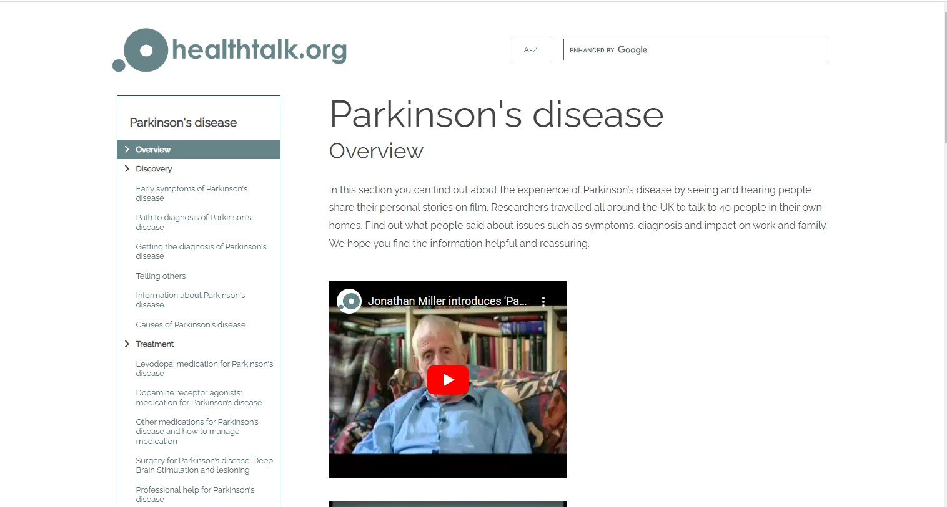
Living with Parkinson Disease
https://healthtalk.org/parkinsons-disease/overview

Slide 26
Diagnosis and disease course
Early diagnosis difficult
History and clinical examination
Lab test and neuroimaging usually normal
Slowly progressive
Hoehn-Yahr classification of disability scale
Mortality usually due to secondary complications

Slide 27
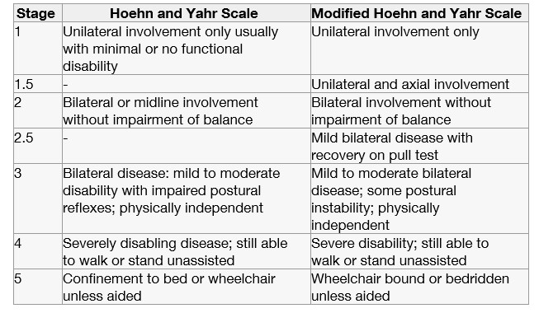
Clinical Staging of PD: Modified Hoehn & Yahn Scale
Stage | Median TtT (mth)
1 | -
2 | 20
2.5 | 62
3 | 25
4 | 24
5 | 26
Zhao YJ et al. (2010)
H-Y scale has been supplanted into the UPDRS
Hoehn M, Yahr M, 1967

Slide 28
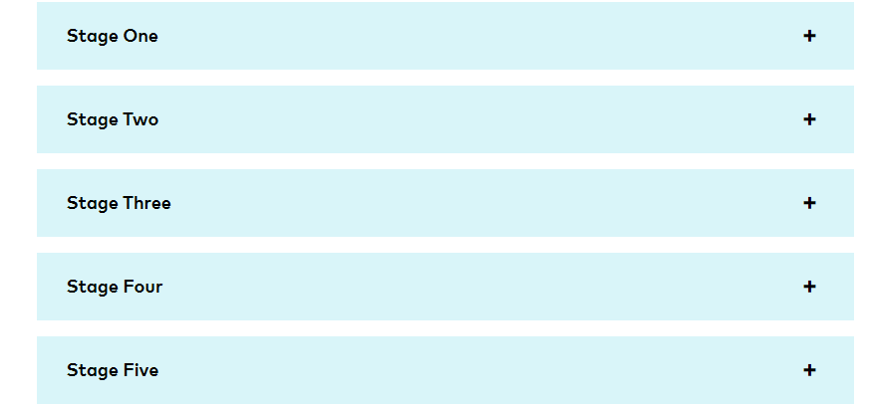

Slide 29

STAGING OF PD

Slide 30
Unified Parkinson Rating Scale (UPDRS)
UDPRS
Part I: evaluation of mentation, behaviour, and mood
Part II: self-evaluation of the activities of daily life (ADLs) including speech, swallowing, handwriting, dressing, hygiene, falling, salivating, turning in bed, walking, and cutting food
Part III: clinician-scored monitored motor evaluation
Part IV: complications of therapy
Part V: Hoehn and Yahr staging of severity of Parkinson's disease
Part VI: Schwab and England ADL scale
MDC –UPDRS
Part I (non-motor experiences of daily living),
Part II (motor experiences of daily living),
Part III (motor examination) and
Part IV (motor complications).
(Fahn et al. 1987)

Slide 31
Medical Management
No cure for PD
Pharmacological management:
–Levodopa (L-dopa) – mainstay of therapy
  Usually reserved for patients in middle & late stages
  Initial improvement often dramatic “honeymoon period”; long term use
effectiveness deteriorates
  End-of-dose deterioration ; On-off phenomenon
–COMT – catecholamine-O-methyltransferase
–Monoamine oxidase (MAO)
–Amantadine
– Side effects are common with drug management
Surgery is considered (more advanced cases)
Deep brain stimulation (DBS)
Nutritional management, surgical management

Slide 32
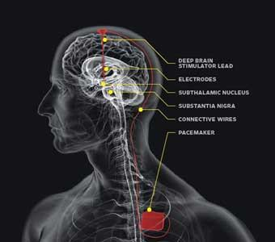
Subthalamic nucleus deep brain stimulation

Slide 33
Subjective History
Parameter | What to look for?
Problems | Patients stated problems
Course of the disease | Onset, how long, results of earlier diagnostics, severity and nature of the condition
Participation problems | Relationships, profession, work, social life and leisure activities
Impairments & activity limitations | Impairments – Freezing, rigidity, tremor, posture, balance, falls, Activity: transfers, reaching & grasping, gait Other: influence of tiredness, time of the day and medication on symptoms
Physical activity | Frequency, Intensity, Time and Type (FITT)
Falls Risk | Incidence of falls and near falls – use history of fall questionnaire or Falls Efficacy Scale
Co-Morbidity | Pressure sores, osteoporosis and mobility –limiting disorders e.g OA, RA, heart failure, COPD.
Treatment | Current treatment (e.g. medication OR Rehab & outcome)
Other factors | Cognition, personal and external factors

Slide 34
Examination of the client with PD
Gait assessment
  Speed and distance, forward and backward , stride length, cadence
  Ability to alter speed
Transfers
  sitting, sit to stand, stand to sit, lying to sitting and back again, rolling in bed, getting in and out of car
Passive ROM
  Spine, UL & LL joints, muscles – calf, hamstrings etc
Postural alignment
  Tragus to wall distance
General Strength
  Trunk, knee, ankle, hip muscle groups etc
Chest expansion
  Functional capacity and vital capacity
Balance
  static & dynamic balance, multi-tasking, freezing - causes

Slide 35
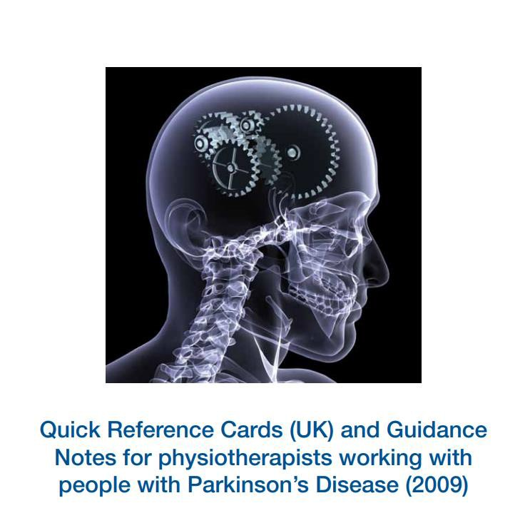
Quick diagnosis
card
https://www.parkinsons.org
.uk/sites/default/files
/2017-
12/quickreferencecar
ds_physio.pdf

Slide 36
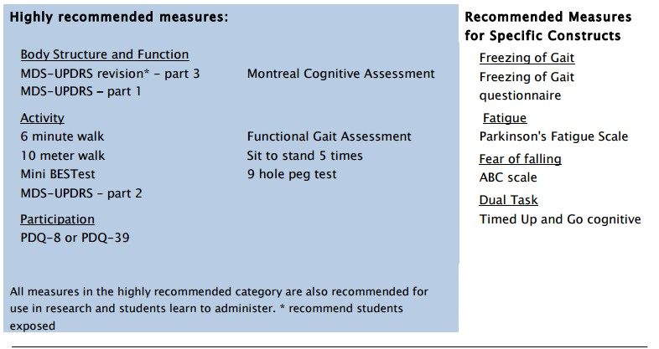
Outcome measures
PD-EDGE TASK FORCE

Slide 37
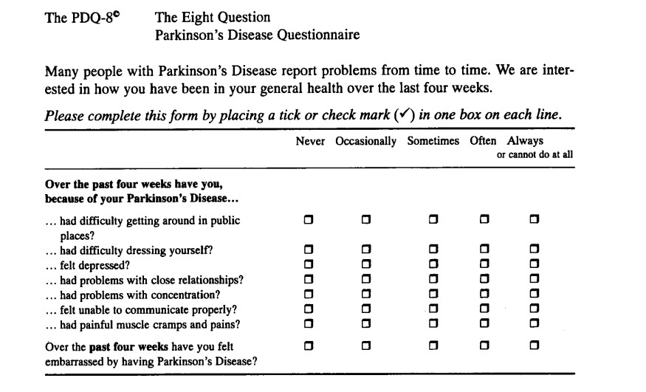
Jenkinson C et al. 2007

Slide 38
Phases, physio goals & possible interventions
HY 1 - 2.5
Treatment goal Prevent inactivity
Prevent fear of moving & falling
HY 2 - 4
Added treatment goal
Prevent falling
Reduce limitations on
core areas: transfers,
HY 5
Added treatment goal
Maintain vital functions Prevent pressure sores Prevent contractures
Maintain or improve
posture, reaching & grasping, balance, gait
physical capacity
Added Intervention
Active & functional-task
Added Intervention
Postural adjustments: bed, wheelchair
Assisted active exercise
Supply info to prevent pressure sores and contractures
Intervention
Promote active lifestyle
Supply info to prevent
inactivity & improve physical capacity
Active (group)
exercises to improve
balance, muscle
power, joint mobility, and aerobic capacity
Involve partner or carer
exercises (at home) using:
General strategies
PD specific strategies: Cognitive movement, Cueing
Supply info to reduce multitasking

Slide 39

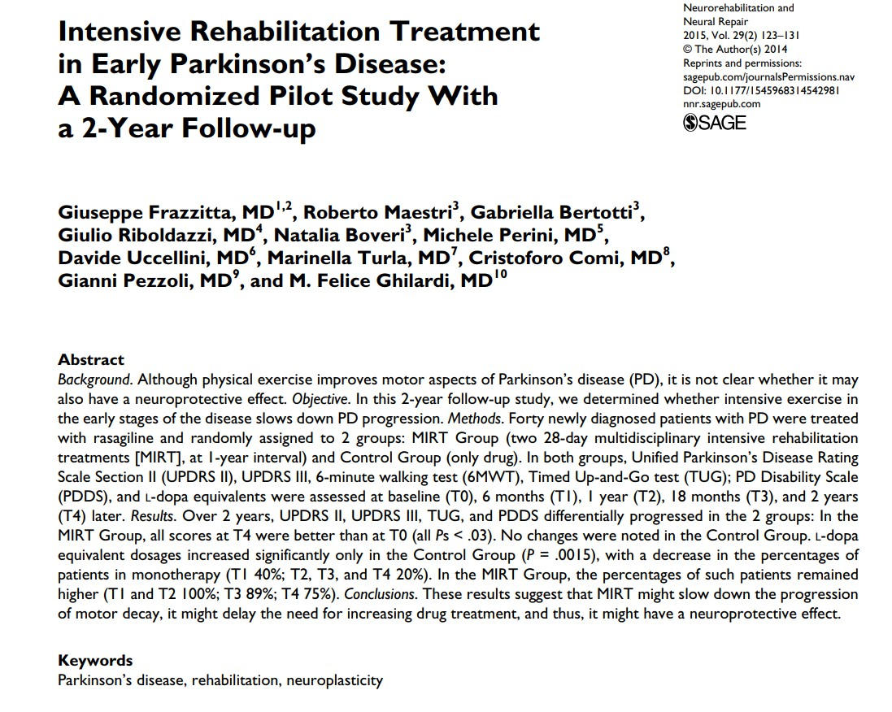
Frazzitta G et al. 2015

Slide 40
General Principles of physiotherapy management
Improve functional independence
  6 core areas
    transfers, posture, reaching and grasping, balance and falls, gait, physical capacity and inactivity
Provision of advice: safety at home
Hammarlund et al., 2014

Slide 41
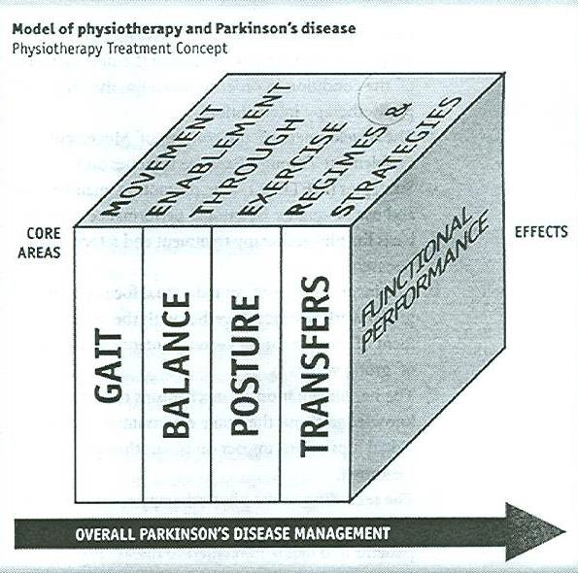
Contemporary physiotherapy philosophy
Core areas
Walking & Balance training have beneficial effects
(Ashburn et al. 2007; Nieuwboer et al. 2007 Hackney & Earhart, 2008)
Strategies to cue movement: visual, auditory, tactile, cognitive

Slide 42
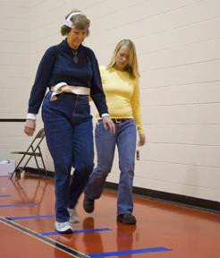
Gait training according to disease stage
Newly diagnosed:
repetitive task practice
cueing strategies
dual tasking (if sufficient cognitive ability)
treadmill training with/without musical beat
RESCUE TRIAL OF CUEING (Nieuwboer
et al. 2007)

Slide 43

Gait training according to disease stage
After starting Levodopa:
Assessment during “on”/”off” phase
Education about presence/timing of symptoms
Approaches
  Attentional strategies
  Cueing strategies
  Cognitive strategies
Used for other functional activities also

Slide 44
Gait training according to disease stage
Five to eight years after starting medication:
Cognitive strategies continued
Monitoring walking patterns and balance during tasks to avoid tripping and falling
Teach separate strategies for when “on” or “off” medication cycle
Turning strategies (Hulbert et al., 2014)
Avoid secondary tasks
Advanced disease: other strategies plus scanning environment for hazards; walking aids: 4-wheeled walking frames
End-stage management: education and support to enable participation in daily life

Slide 45
Physiotherapy Interventions: Balance
Physiotherapy intervention can improve balance in PD patients
  Progressive dual task aquatic exercises (Silva AZD et al. 2019)
  Therapist supervised and home-based exercise programme (Atterbury & Welman 2017)
  Home based exercises reduced falls rate in falling PD
(Ashburn A et al. 2007)
  PwPD are able to improve their postural motor control through practice (Pauls SS et al. 2018)
    Worsening of axial and cognitive symptoms may result to diminished learning

Slide 46
Contemporary physiotherapy philosophy
Core areas
Walking & Balance training have beneficial effects
(Ashburn et al. 2007; Nieuwboer et al. 2007 Hackney & Earhart, 2008)
Strategies to cue movement: visual, auditory, tactile, cognitive

Slide 47
Physiotherapy Interventions: strategies to cue movement
Cues: Classified based in terms of:
  Modality: visual, auditory or somatosensory
  Parameter: timing or spatial
  Specification: specific step length (in cm) or step frequency
Modality | Parameter | Examples | Gait parameters
Visual | Step Amplitude Step frequency | Lines on floor Patterned carpet Walking stick with LASER beams | ↑ Step size Modify step rate (cadence)
Auditory | Step frequency & amplitude | Metronome beat Musical rhythm | Modify step rates ↑ Step size
Somatosensory | Step frequency | Rhythmic vibrations Electrical pulse Touch Treadmill | Modify step rate
Attention | Step amplitude | Concentrating on taking big steps | ↑ Step size

Slide 48
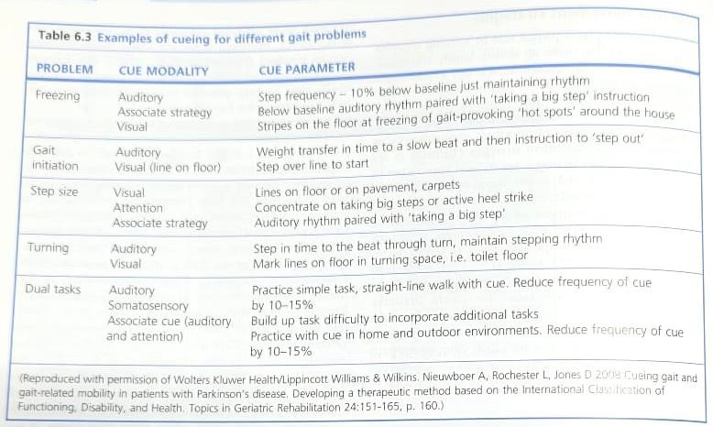
Example of cueing strategy for different gait problems

Slide 49
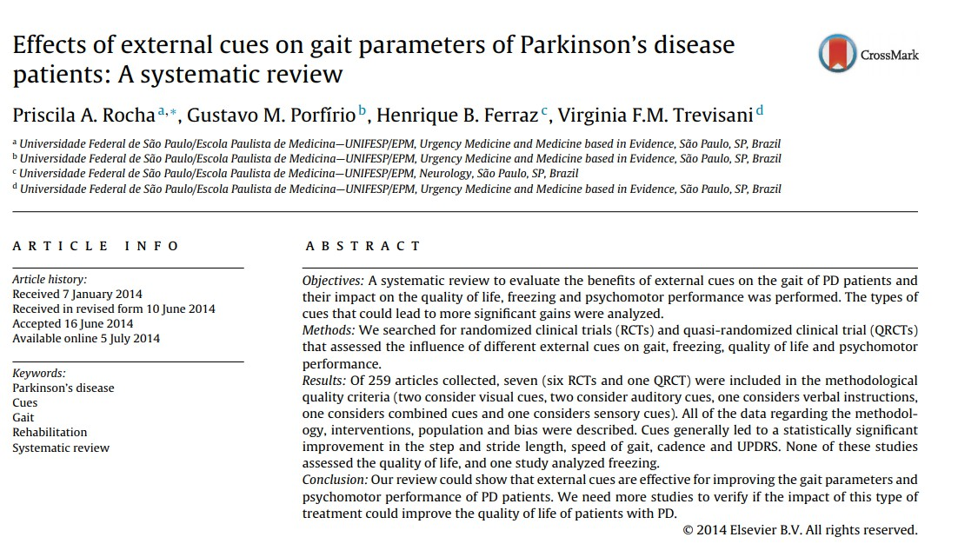
Cue training in the home improves:
  Gait related mobility (Nieuwboer et al. 2007)
  Physical activity in PD patients (Lim I et al. 2010)
Rocha PA et al. 2014

Slide 50
Contemporary physiotherapy philosophy
Core areas
Walking & Balance training have beneficial effects
(Ashburn et al. 2007; Nieuwboer et al. 2007 Hackney & Earhart, 2008)
Strategies to cue
movement: visual, auditory, tactile,
cognitive
Transfers training
  Sit to stand
  Turning over in bed
  Dual Tasking

Slide 51
Contemporary physiotherapy philosophy
Musculoskeletal integrity
  Flexibility exercises – active + passive ROM, stretching
  Strengthening exercises – (Keus SHJ et al.
2009) 2015
    Roeder L et al. meta-analysis showed benefit for muscle strength
    Shulman LM et al. (2013) – found 3 types exercises improved distance in 6mins walking test,
– high intensity treadmill/low
intensity/stretching with resistance training
Exercise to promote physical activity – tango dancing, boxing, active cycling

Slide 52
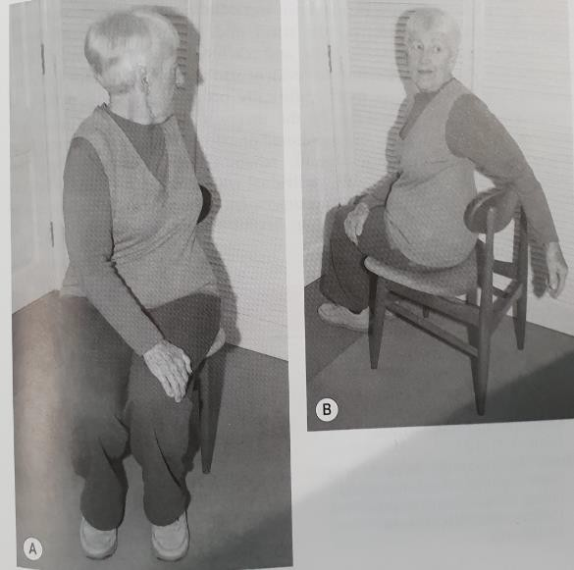
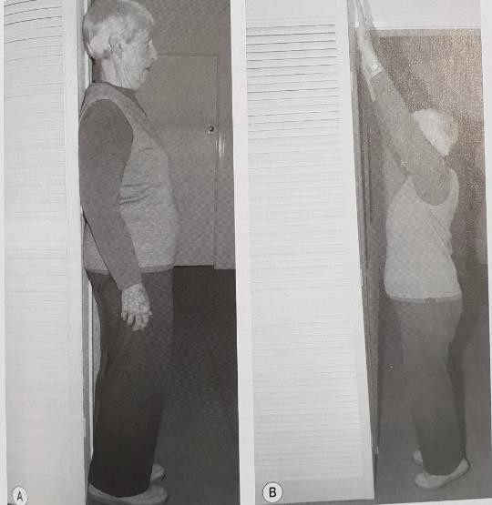
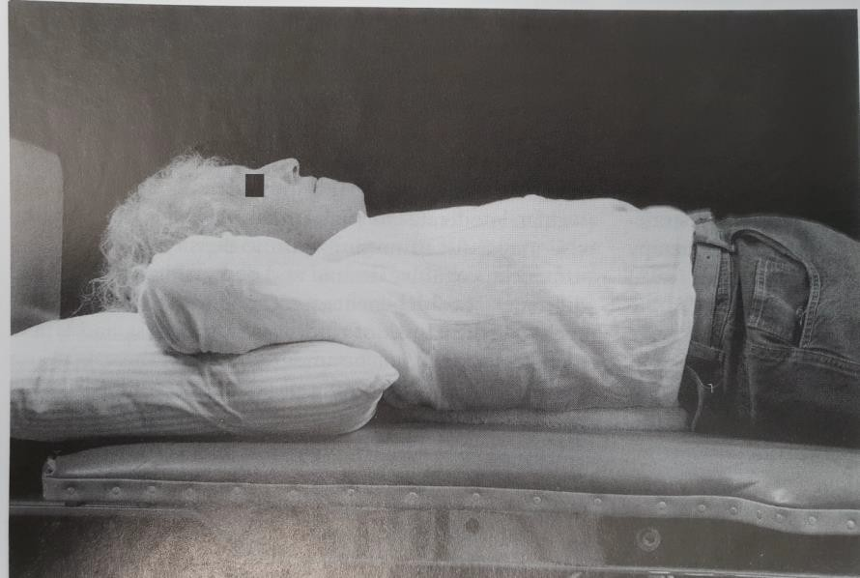

Slide 53
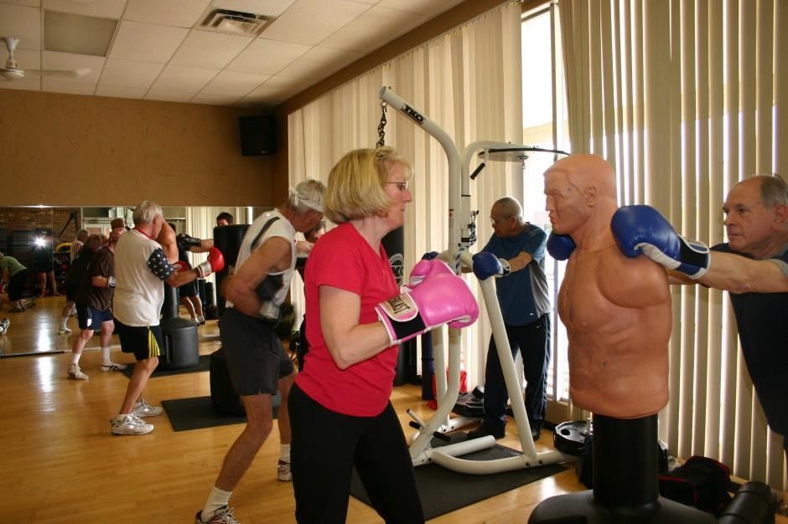
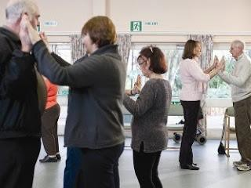
Exercise for people with PD
Tango dancing for people with
PD (Duncan and Earhart, 2012)
Indianapolis Rock Steady Gym – boxing for people with PD (Combs et al., 2011)
Dance in PD: Meta-analyses:
Shanahan et al., 2015
http://www.youtube.com/watch?v=1cb3x6d dwCQ

Slide 54
Aerobic training
PwPD improve VO₂ max with either low intensity or high intensity
aerobic exs (Shulman et al. 2013; Schenkman M et al 2012)
Large study of aerobic walking trial found improvement in VO₂ max, motor signs, walking speed, executive function, fatigue, depression and quality of life (Uc et al. 2014)
Need to exercise at least at moderate intensity (65 -70% HR max)
The jury is still out on the effect of aerobic exercise on motor signs

Slide 55
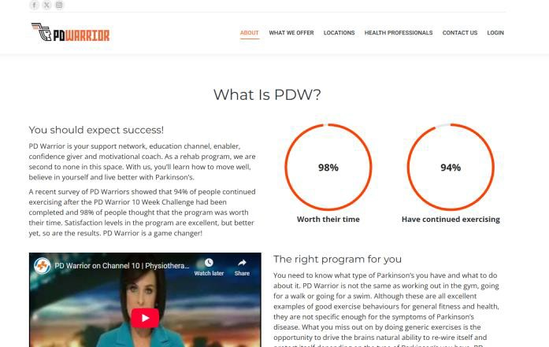
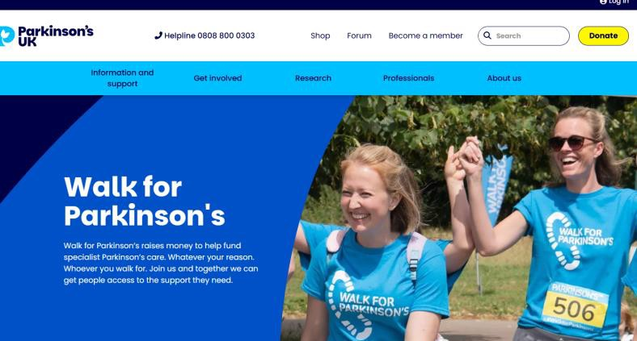
Contemporary physiotherapy philosophy
Falls prevention
  Patient education
  Balance training
  Exercises
Patient and family education
  Refer patient to support groups e.g. Parkinson UK, PD warrior

Slide 56
Exercise for falls prevention (Canning et al., 2015)
An exercise program targeting balance, leg strength, and freezing of gait did not reduce falls but improved physical and psychological health.
Falls decreased in people with milder Parkinson disease only.

Slide 57
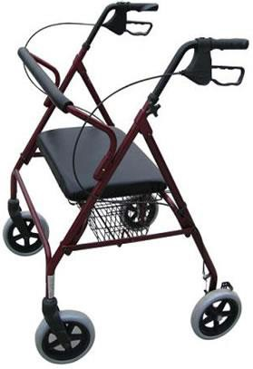
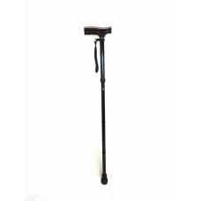
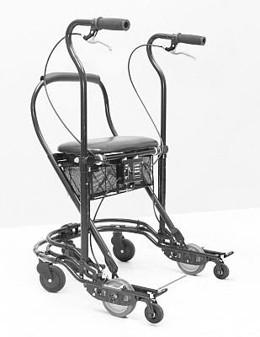
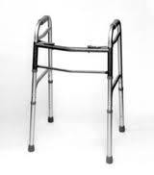
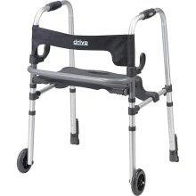
Walking aids
YES
Kegelmeyer et al., 2013

Slide 58
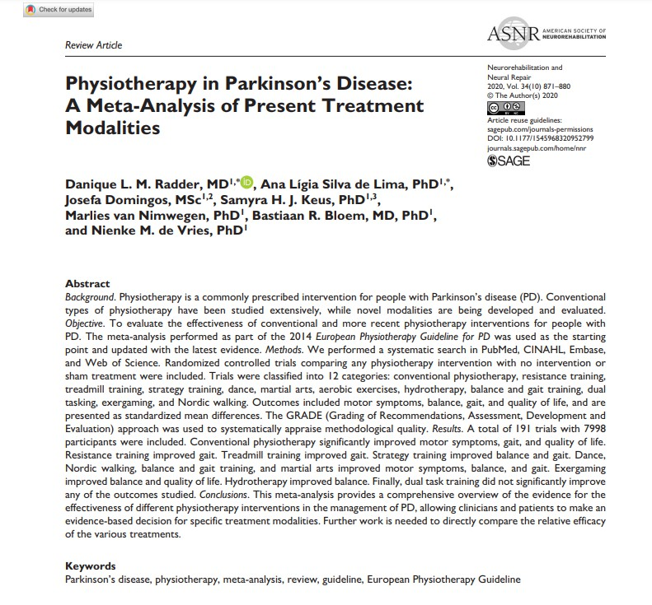
Recent meta-analysis of present treatment
Conventional PT
•
improved motor symptoms,

Slide 59
Summary
PD is a chronic, progressive disorder of the basal ganglia characterised by the cardinal features of rigidity, tremor, and bradykinesia
Pharmacological interventions have become the mainstay of treatment
Physiotherapy interventions focus on management of strength, ROM, endurance and functional skills, balance, gait according to disease stage
MDT involvement at all stages to provide psychosocial support as needed and to direct patient towards maintenance of function

